Slide 1
Pulse PT
Rafael Montes
Parth Desai
Sam Bohr
Andrew Alhaj
Daniel Christenson
Julian Ajja

Slide 2
Risks and Challenges
Coming up with intuitive UI designs
Reading HR
Uncertainty
Reactstrap familiarization
Learning React Router
Learning Redux
Rafael
Parth
Sam
Andrew
Daniel
Julian

Slide 3
User Stories for UI Design
As a trainee I want a intuitive and simple home page so that I can pick up and use the app immediately
As a trainer I want an intuitive and visually appealing dashboard so that I can spend more time focusing on my clients rather than spending a lot of time learning how to navigate the site.
As a trainer I would like a visually appealing profile page so that I may be able to attract potential clients
As a trainer I would like to be able to clearly see my clients information so that my work stays organized.

Slide 4

Login and Registration
As a Trainer, I want to be able to easily make an account with a simple and easy to use interface to make the site rewarding to engage with.
Conceptual UI
Implementation of UI utilizing CSS for design
Testing

Slide 5
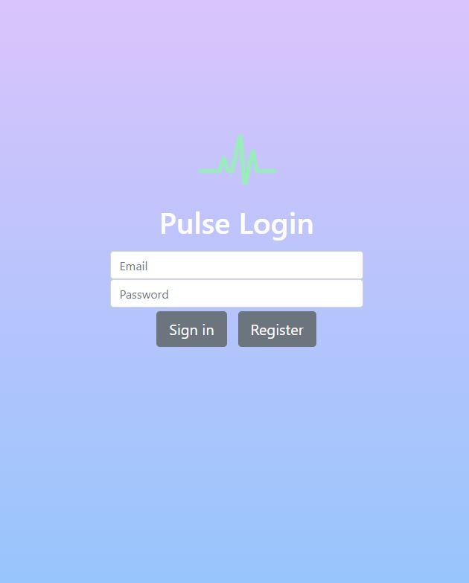
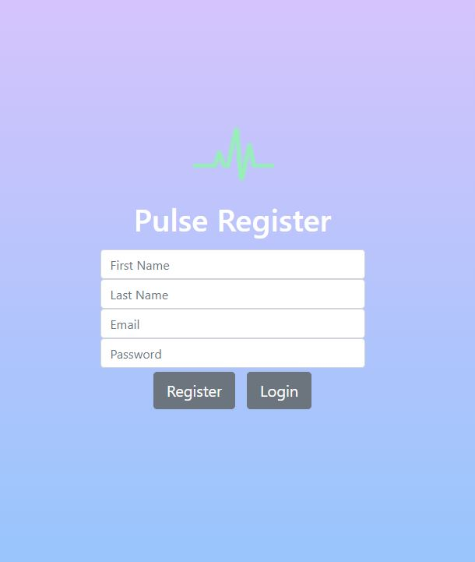
Login And Registration Pages

Slide 6
User Stories for Mobile Homepage
As a trainee I’d like to be able to navigate the app via tabs so that I can quickly navigate through the app.

Slide 7
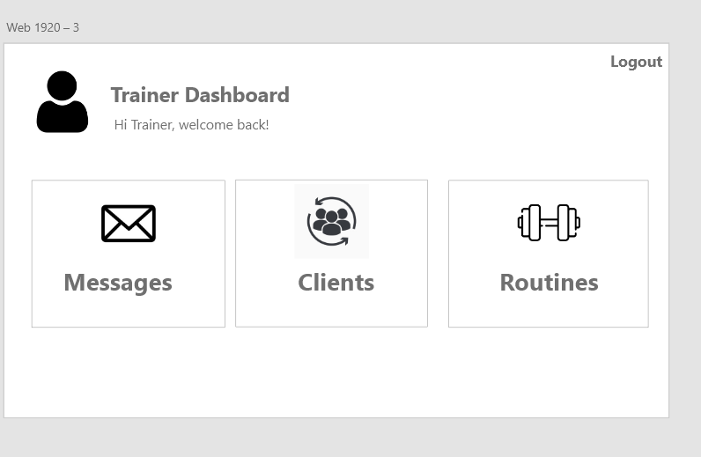
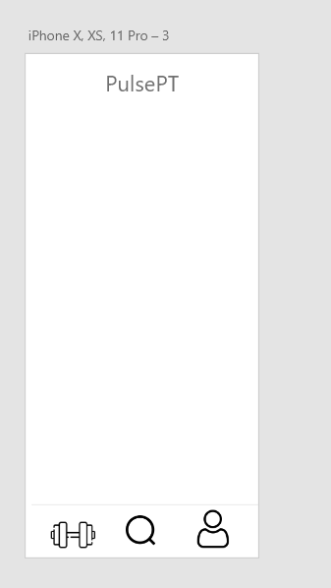
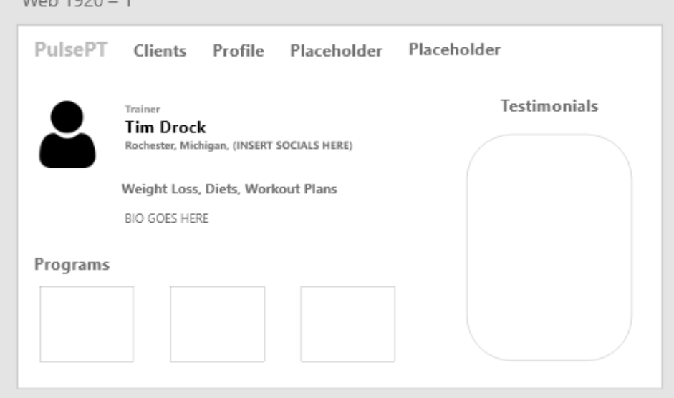
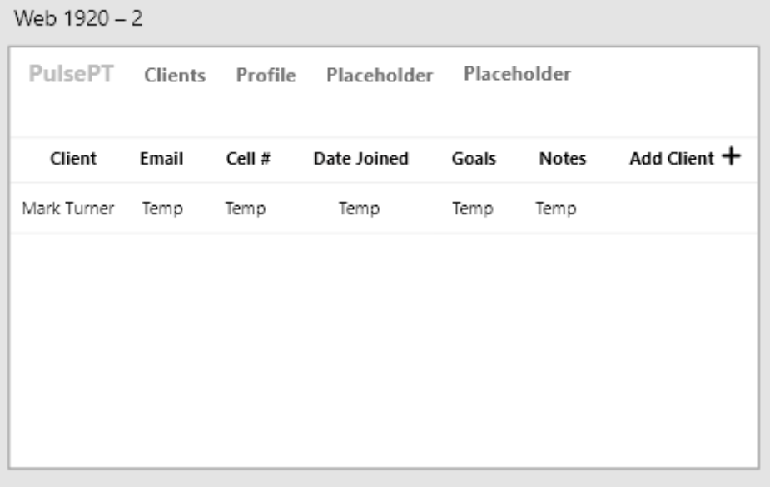
Conceptual UI Design

Slide 8
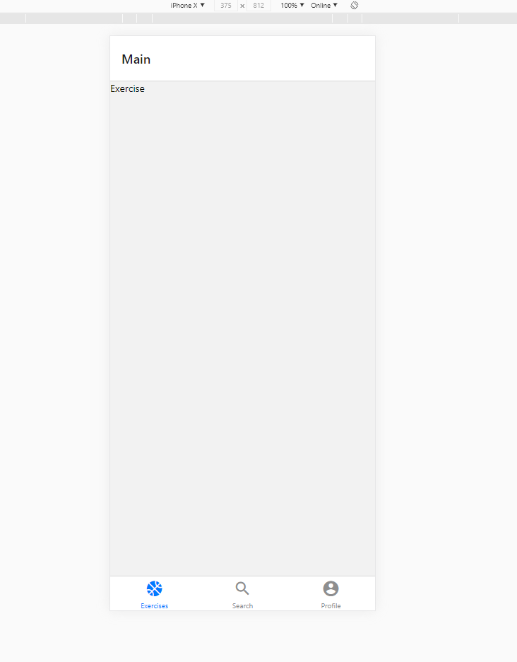
Mobile Home Page

Slide 9

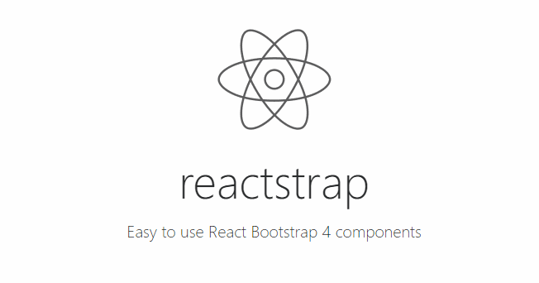
Navigation Bar
User Story: As a trainer, I would like to be able to easily navigate between different pages on the website, as well as login and logout.
Research
Create Navbar
Create Pages to route
Link Navbar with react router
Test

Slide 10
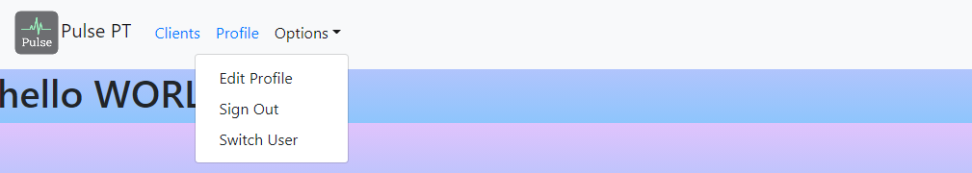
Navigation Bar

Slide 11


Database Model
User Story: As a subscriber/trainer, I would like to upload my data to my profile, so it saves within the app.
Research
Create database schema
Find where to host database
Implement the code
Test

Slide 12
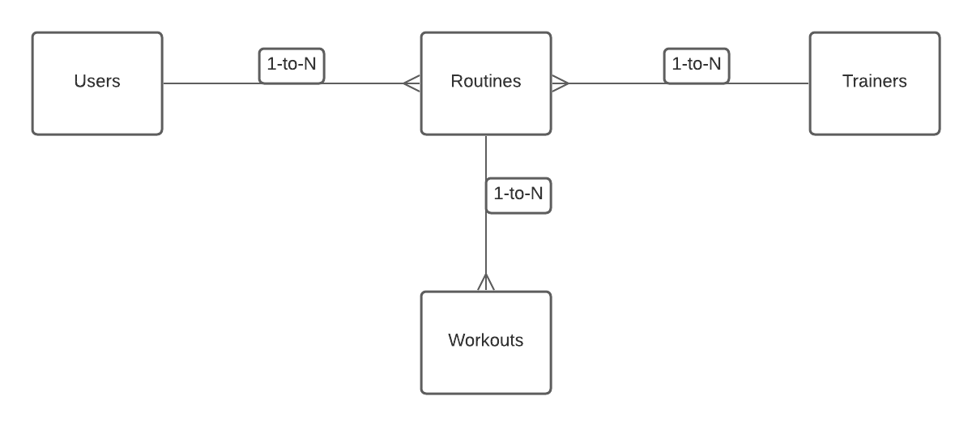
Collections Relationship Diagram

Slide 13
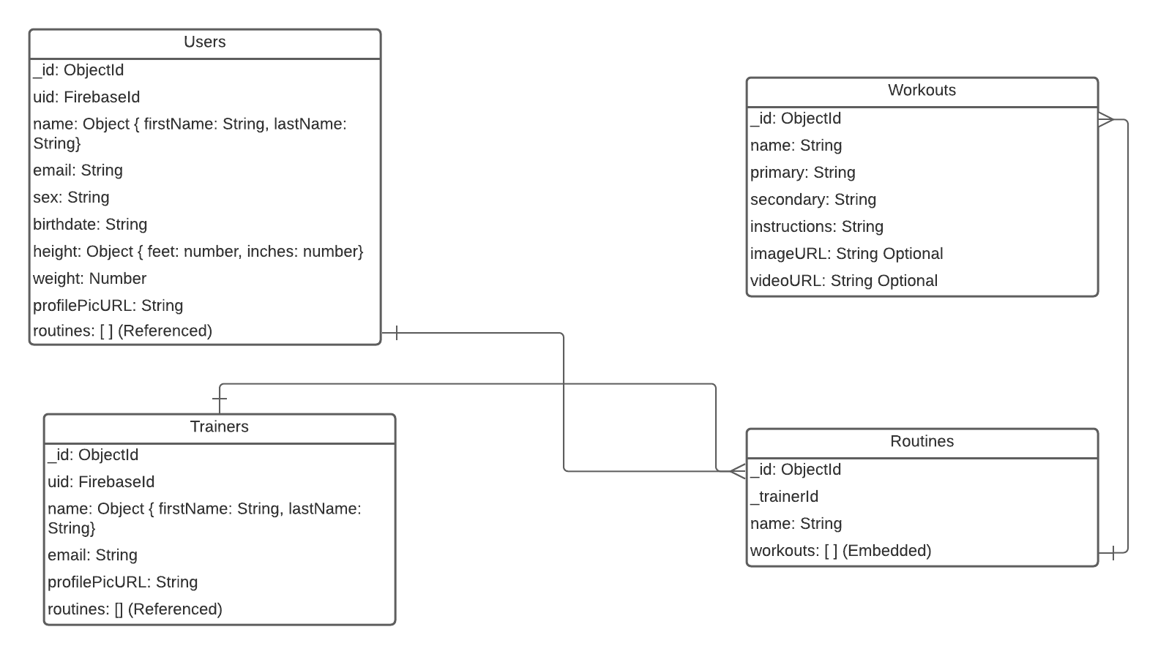
Collections

Slide 14
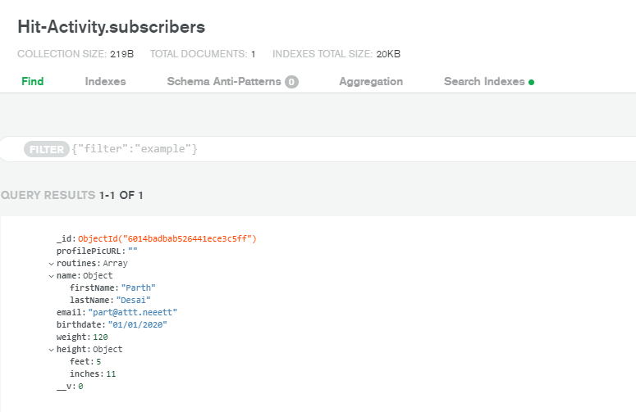
Mongo Cloud Service

Slide 15

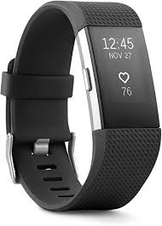
Heart Rate Data
User Story: As a subscriber I would like to be able to view my heart rate data to find out if certain routines are effective.
As a trainer I would like to be able to view my clients heart rate data in order to determine effectiveness of my routines.
A lot of research
Fitbit API
OAuth 2.0
Testing

Slide 16
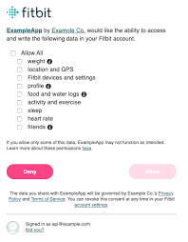

Slide 17
Mobile
Subscriber
Post profile Data to database
Access Data based on user ID
Search From List of Trainers

Slide 18
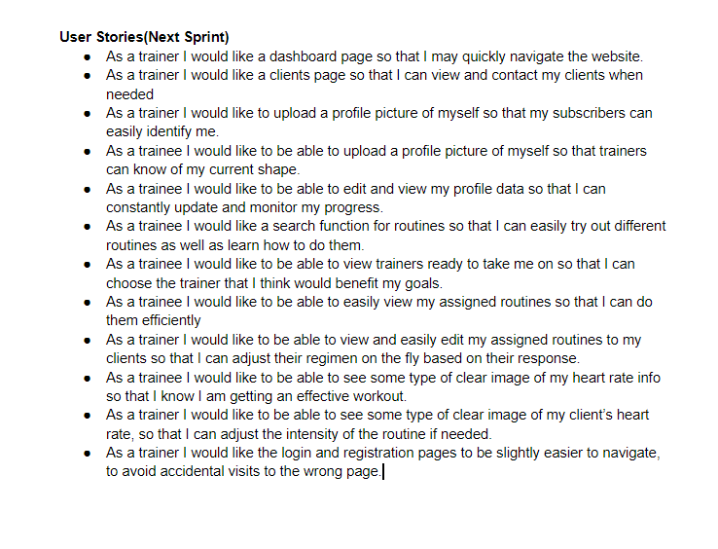
Next Sprint Objectives

Slide 19
Demo

Slide 20
THANKS

